Slide 1
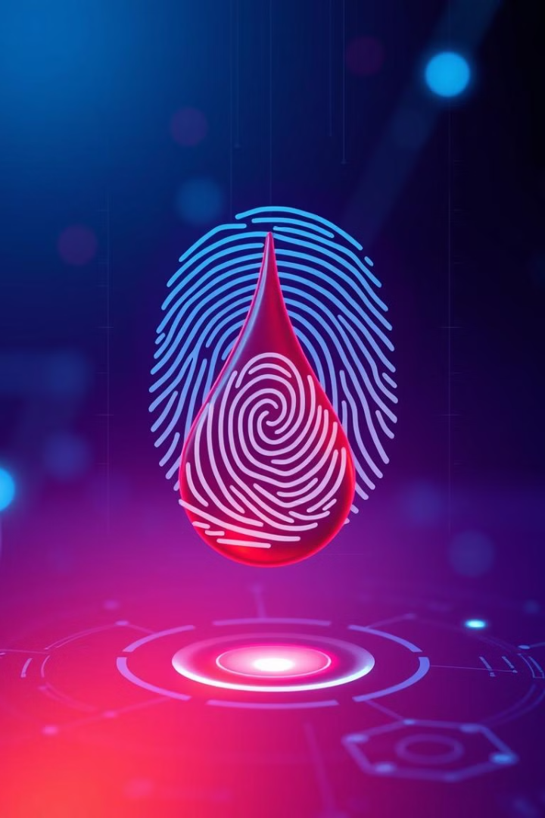

ZEROTH REVIEW
A Project on
Fingerprint-Based Blood Group Detection Using Deep Learning and Image Processing
Submitted by
PARASURAM T 512221205012
PARASURAMAN K 512221202013
CO-ORDINATOR
MS. M.SAMHITHA, M.E.,
Department of Information Technology
GUIDE
Dr. V. RAJI, M.E., Ph.D.,
Department of Information Technology

Slide 2
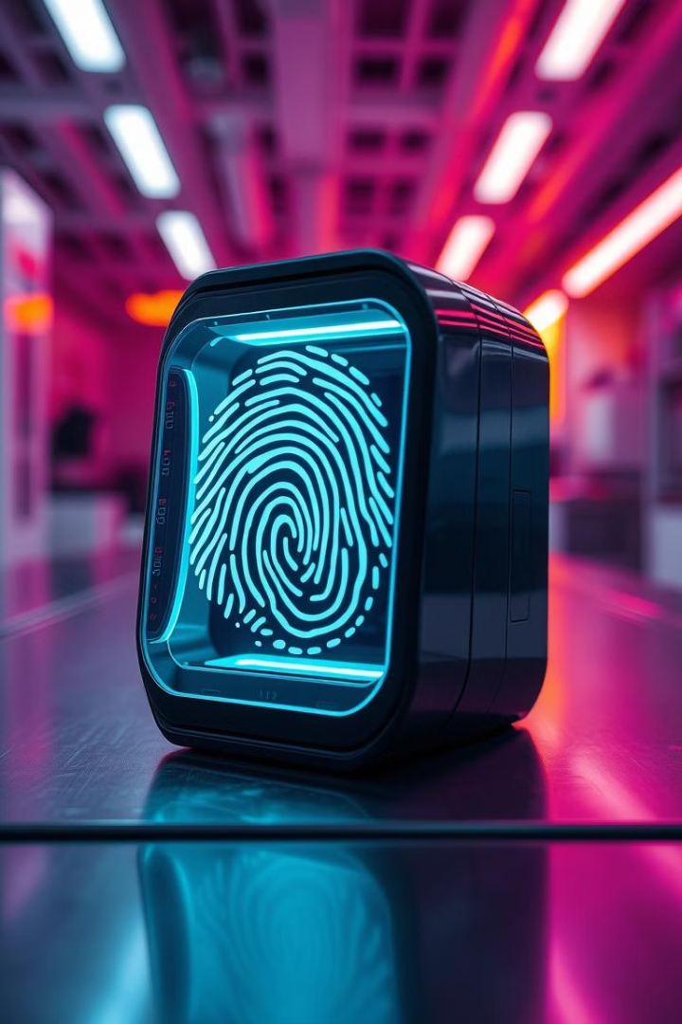
Project Title & Relevance
1
Clarity and Relevance
2
Traditional blood testing requires lab-based analysis, while this approach offers a non-invasive, fast, and cost-effective alternative.
The project aims to detect blood groups from fingerprint images using Deep Learning and Image Processing techniques.
3
The project has medical, forensic, and biometric security applications, making it relevant for real-world use.

Slide 3
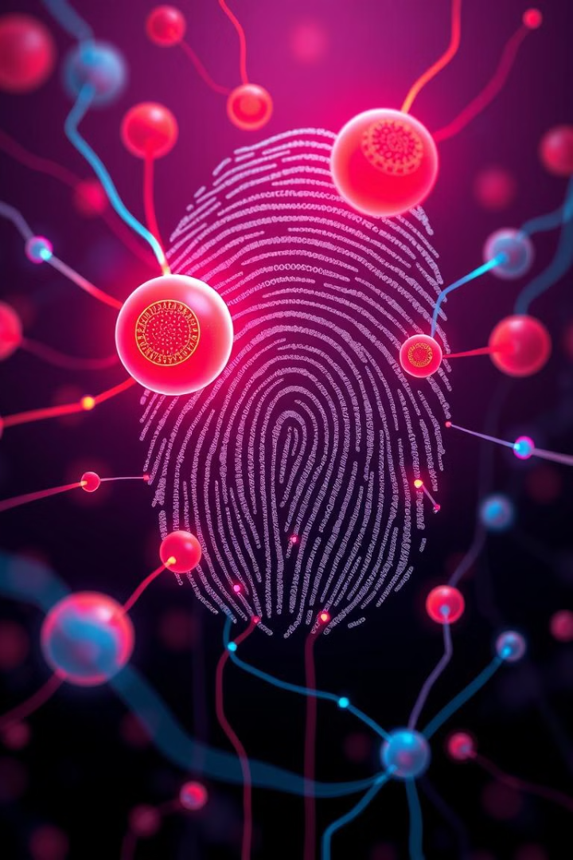
Introduction
1
Background & Motivation
Blood group detection is crucial in medical emergencies, organ transplants, and forensic investigations.
2
Existing methods rely on blood sample analysis, which can be time-consuming, invasive, and requires specialized equipment.
3
Fingerprint patterns are unique for individuals and have potential correlations with blood group types.
4
Using CNN-based deep learning models, we aim to develop a system that accurately predicts blood groups from fingerprint images.

Slide 4
Literature Review
Paper Title
Authors
Year
Methodology Used
Pros
Cons
Blood Group Determination Using Fingerprint
T. Nihar, K. Yeswanth, K. Prabhakar
2024
CNN (LeNet, AlexNet), Ridge Frequency Analysis, Gabor Filters
Non-invasive approach, potential for real-time use
Accuracy not specified, requires a larger dataset
A Novel Approach to Predict Blood Group using Fingerprint Map Reading
P. N. Vijaykumar, D. R. Ingle
2021
Ridge Frequency Estimation, Gabor Filters, Multiple Linear Regression (OLS)
Cost-effective, uses fingerprint ridge features
Low accuracy (62%), lacks deep learning advancements
Fingerprint-Based Blood Group Prediction Using Deep Learning
Swathi P, K. Sushmita, Horadi
2024
Convolutional Neural Networks (CNNs)
Deep learning approach, improved feature extraction
Accuracy only 62%, requires better dataset quality

Slide 5
Thoroughness & Relevance
Existing Work & Project Contribution
Previous research has explored biometric-based blood group detection using fingerprints, iris scans, and genetic markers.
Existing studies primarily use statistical and image-processing techniques rather than deep learning-based models.
Deep learning, particularly CNN architectures (LeNet, AlexNet, ResNet, and VGG), has shown promise in medical image classification.
This project enhances accuracy by leveraging ResNet34, which has better feature extraction and generalization capabilities.
Studies indicate that certain minutiae points in fingerprints might correlate with blood group types, though extensive research is still needed.
Unlike conventional methods, this approach can provide instant results without requiring blood samples.

Slide 6
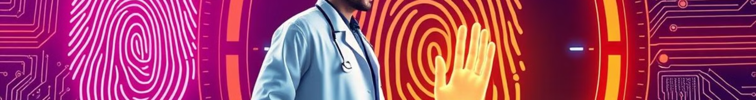







Problem Statement
Clearly Defined Problem
Current blood group identification methods are invasive, time-consuming, and require laboratory equipment.
There is no widely accepted non-invasive and AI-driven method for blood group detection.
Manual fingerprint analysis lacks precision and consistency in identifying biometric-blood group patterns.
Alignment with Project Objectives
Develop a deep learning-based model capable of predicting blood groups from fingerprint images.
Compare various CNN architectures (LeNet5, AlexNet, VGG16, ResNet34) to determine the most effective model.
Implement a user-friendly interface using Django for real-time predictions.
Improve accessibility, especially in remote areas where lab-based testing is challenging.

Slide 7
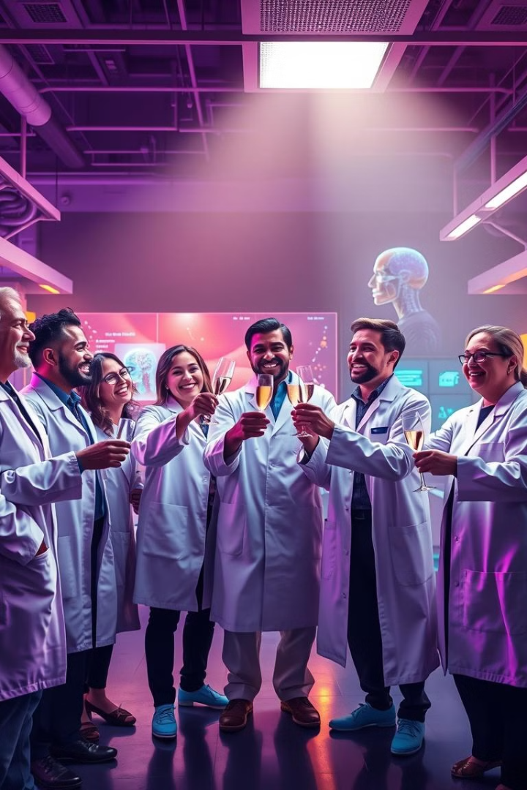
Conclusion
Key Takeaways
The project explores an innovative non-invasive approach to blood group detection.
It leverages deep learning and image processing to improve accuracy and efficiency.
ResNet34 has shown promising results, outperforming other models in validation accuracy.
Future work will focus on expanding datasets, optimizing models, and integrating real-time applications.

Slide 8

Thank You!

